Slide 1
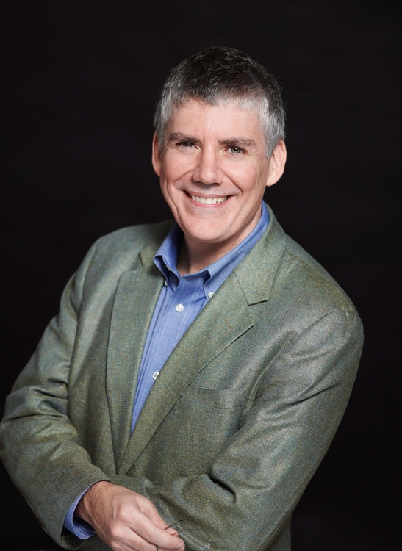
Rick Riordan

Slide 2

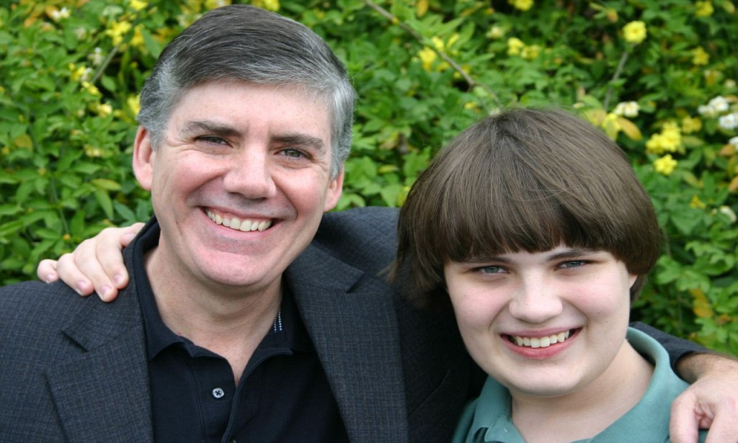
Background:
Born in San Antonio, TX
Graduated, University of Texas
Married to Becky Riordan
Two children, Patrick and Haley Riordan

Slide 3
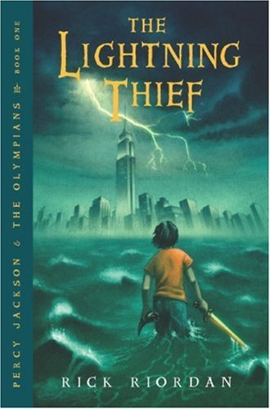
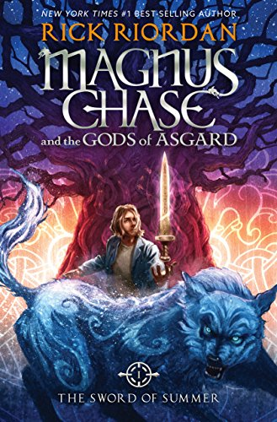

Achievements:
“Percy Jackson and The Lightning Thief” series
Four other mythology-based series
Mark Twain Award for “The Lightning Thief”

Slide 4


Legacy:

Slide 5
Rick Riordan

